Slide 2
Topics
Dictionaries
Sets

Slide 3
Dictionaries
A dictionary is an object that stores a collection of data.
Each element that is stored in a dictionary has two parts: a key and a value.
  Syntax: dictionary_name = {key1:val1, key2:val2, …}
For example, let’s say that we want to write a program that lets us look up a student’s name by entering their ID number.
We could create a dictionary in which each element contains a student ID number as the key, and that their name as the value.

Slide 4
Dictionaries
Example:
student_records = {101 : 'Julia', 102 : 'Paul', 103 : 'Leela’}
print(student_records)
In this example, the keys are integers, and the values are strings.
The values in a dictionary can be objects of any type, but the keys must be immutable objects.
  For example, keys can be strings, integers, floating-point values, or tuples.
  Keys cannot be lists or any other type of immutable object.

Slide 5
Retrieving a Value from a Dictionary
When you want to retrieve a specific value from a dictionary, you use the key that is associated with that value.
  This is similar to the process of looking up a word in a dictionary, where the words are keys, and their definitions are values.
Syntax: dictionary_name[key]
  Example: print(student_records[102])
Note that you cannot use numeric index to retrieve a value by its position from a dictionary.
  The following will raise an error: print(student_records[1])

Slide 6
Retrieving a Value from a Dictionary
If the key does not exist in the dictionary, a KeyError exception is raised.
Example: print(student_records[105])
To prevent such an exception, you can use the in and not in operators to determine whether a key exists before you try to use it to retrieve a value.
if 105 in student_records:
print(student_records[105])
else:
print('Record not found.')

Slide 7
Adding Elements to an Existing Dictionary
Dictionaries are mutable objects.
To add a new key-value pair:
dictionary_name[key] = value
  If the key exists in the dictionary, the value associated with it will be changed.
Example: student_records[104] = 'Yi-joon’
  The dictionary now has four student records.

Slide 8
Deleting Elements
To delete a key-value pair, use the del statement: del dictionary[key]
  If key is not in the dictionary, KeyError exception is raised
Example: del student_records[104]

Slide 9
Getting the Number of Elements
len function: used to obtain number of elements in a dictionary
Example: len(student_records)

Slide 10
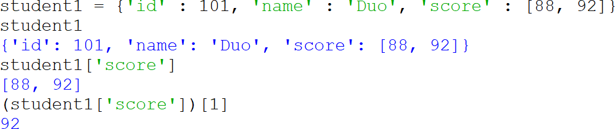
Mixing Data Types in a Dictionary
The values that are stored in a single dictionary can be of different types.
The keys can be of different types, too, as long as they are immutable.
Example:
student1 = {'id' : 101, 'name' : 'Duo', 'score' : [88, 92]}

Slide 11
Creating an Empty Dictionary
To create an empty dictionary:
  You can use {}
  Or use the built-in function dict()
Example:
phonebook = {} OR phonebook = dict()
After the above executes, the phonebook variable will reference an empty dictionary.
Elements can be added to the dictionary as program executes.

Slide 12
Using for Loop to Iterate Over a Dictionary
General format: for key in dictionary:
phonebook = {'Chris':'555−1111', 'Katie':'555−2222}
for key in phonebook:
print(key, phonebook[key])

Slide 13
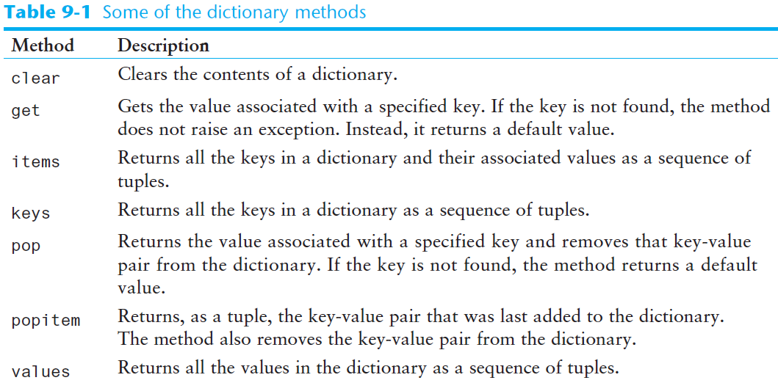
Some Dictionary Methods (cont’d.)

Slide 14
Some Dictionary Methods
clear method: deletes all the elements in a dictionary, leaving it empty
  Format: dictionary.clear()
  Example: phonebook.clear()

Slide 15
Some Dictionary Methods
get method: an alternative to the [] operator for getting a value from a dictionary. The get method does not raise an exception if the specified key is not found but returns a default value.
  Format: dictionary.get(key, default)
  Example: phonebook.get(‘Annie', 'Entry not found')

Slide 16
Some Dictionary Methods (cont’d.)
items method: returns all the dictionaries keys and associated values. They are returned as a special type of sequence known as a dictionary view. Each element in the dictionary view is a tuple, and each tuple contains a key and its associated value.
  Format: dictionary.items()
  Example:
phonebook = {'Chris':'555−1111', 'Katie':'555−2222'}
print(phonebook.items())
# returns dict_items([('Chris', '555−1111'), ('Katie', '555−2222')])

Slide 17
Some Dictionary Methods (cont’d.)
Use a for loop to iterate over the tuples in the dictionary view
  Can use a variable which receives a tuple, or can use two variables which receive key and value
phonebook = {'Chris':'555−1111', 'Katie':'555−2222’}
# Using one variable to receive a tuple
for t in phonebook.items():
print(t[0], t[1])
# Using two variables to receive key and value from a tuple
for key, value in phonebook.items():
print(key, value)

Slide 18
Some Dictionary Methods (cont’d.)
keys method: returns all the dictionaries keys as a dictionary view.
  Format: dictionary.keys()
phonebook = {'Chris':'555−1111', 'Katie':'555−2222'}
print(phonebook.keys())
# prints dict_keys(['Chris', 'Katie’])
for key in phonebook.keys():
print(key)
# prints Chris and Katie on separate lines

Slide 19
Some Dictionary Methods (cont’d.)
pop method: returns value associated with specified key and removes that key-value pair from the dictionary. If the key is not found, a default value is returned
  Format: dictionary.pop(key, default)
phonebook = {'Chris':'555−1111', 'Katie':'555−2222'}
phone_num = phonebook.pop('Katie', 'Element not found')
print(phone_num)

Slide 20
Some Dictionary Methods (cont’d.)
popitem method: Returns, as a tuple, the key-value pair that was last added to the dictionary. The method also removes the key-value pair from the dictionary.
  Format: dictionary.popitem()
  Raises a KeyError exception if called on an empty dictionary.

Slide 21
Some Dictionary Methods (cont’d.)
phonebook = {'Chris':'555−1111', 'Katie':'555−2222'}
phonebook['Joanne'] = '555-3333’
t = phonebook.popitem() # Assign the tuple to t
print(t[0], t[1]) # Joanne 555-3333
# Assigning values of returned tuple to individual variables
key, value = phonebook.popitem()
print(key, value) # Katie 555−2222
print(phonebook) # {'Chris': '555−1111'}

Slide 22

Some Dictionary Methods (cont’d.)
values method: returns all the dictionaries values (without the keys) as a dictionary view.
  Format: dictionary.values()
  Use a for loop to iterate over the values
phonebook = {'Chris':'555−1111', 'Katie':'555−2222'}
for val in phonebook.values():
print(val)

Slide 23
The Dictionary Merge Operator
The dictionary merge operator is the | symbol
It merges two dictionaries into a single dictionary that is the combination of the two
After this statement, dict3 will have all the elements of dict1 and dict2
If the same key appears in dict1 and dict2, the new dictionary keeps the value from the dictionary on the right-hand side of the | operator (in this case, dict2).
dict3 = dict1 | dict2

Slide 24

The Dictionary Merge Operator
Note that the merge operator was introduced in Python 3.9 so if you have an older version of Python, the operator will not be recognized.
Example:
phonebook1 = {'Chris':'555−1111', 'Annie':'555−2222'}
phonebook2 = {'Irene' : '555-3333', 'Annie' : '555-4444'}
phonebook = phonebook1 | phonebook2
for key, value in phonebook.items():
print(key, value)
Note that the key with Annie has a value that is copied from phonebook2 which appears on the right side of the merge operator.

Slide 25
The Dictionary Update Operator
The dictionary update operator is the |= symbol
It works like the dictionary merge operator, except that it assigns the new dictionary to the dictionary variable that appears on the left-hand side of the operator (think of it as an augmented assignment operator).
This statement merges dict1 and dict2, and assigns the resulting dictionary back to dict1
dict1 |= dict2

Slide 26
The Dictionary Update Operator
Note that the update operator was introduced in Python 3.9 so if you have an older version of Python, the operator will not be recognized.
Example:
phonebook1 = {'Chris':'555−1111', 'Annie':'555−2222'}
phonebook2 = {'Irene' : '555-3333', 'Annie' : '555-4444'}
phonebook1 |= phonebook2
for key, value in phonebook1.items():
print(key, value)

Slide 27
Dictionary Comprehensions
Dictionary comprehension is an expression that reads a sequence of input elements and uses those input elements to produce a dictionary
  Dictionary comprehensions are similar to list comprehensions

Slide 28
Dictionary Comprehensions
Example: create a dictionary in which the keys are the integers 1 through 4 and the values are the squares of the keys
numbers = [1, 2, 3, 4]
squares = {}
for item in numbers:
squares[item] = item**2
print(squares)
# {1: 1, 2: 4, 3: 9, 4: 16}
Using a for loop
Using a dictionary comprehension
numbers = [1, 2, 3, 4]
squares = {item:item**2 for item in numbers}
print(squares)
# {1: 1, 2: 4, 3: 9, 4: 16}

Slide 29
Dictionary Comprehensions
squares = {item:item**2 for item in numbers}
Result Expression
Iteration Expression
The dictionary comprehension expression is on the right side of the = operator and is enclosed in curly braces ({}).
The iteration expression iterates over the elements of numbers
Each time it iterates, the target variable item is assigned the value of an element
At the end of each iteration, an element containing item as the key and item**2 as the value is added to the new dictionary

Slide 30
Dictionary Comprehensions
Example: You have an existing list of strings. Create a dictionary in which the keys are the stings in the list, and the values are the lengths of the strings
names = ['Jeremy', 'Guiling', 'Peg']
str_lengths = {item:len(item) for item in names}
print(str_lengths)
# {'Jeremy': 6, ‘Guiling': 4, 'Peg': 3}

Slide 31
Dictionary Comprehensions
Example: making a copy of a dictionary
dict1 = {'A':1, 'B':2, 'C':3}
dict2 = {k:v for k,v in dict1.items()}
print(dict2)
# {'A': 1, 'B': 2, 'C': 3}

Slide 32
Dictionary Comprehensions
You can use an if clause in a dictionary comprehension to select only certain elements of the input sequence
  Example: A dictionary contains cities and their populations as key-value pairs. Select only the cities with a population greater than 2 million (Data from July ‘21 estimate by US Census Bureau)
populations = {'New York': 8467513, 'Los Angeles': 3849297,
'Chicago': 2696555, 'Houston': 23288250,
'Phoenix': 1624569, 'Philadelphia': 1576251}
largest = {k:v for k,v in populations.items() if v > 2000000}
print(largest)
# {'New York': 8467513, 'Los Angeles': 3849297,
# 'Chicago': 2696555, 'Houston': 23288250}

Slide 33
Exercise
Consider the below three dictionaries containing course numbers and the room numbers of the rooms where the courses meet, course numbers and instructors who teach the course, and course numbers and meeting times of the course.
rooms = {'CS101':3004, 'CS102':4501, 'CS103':6755}
instructors = {'CS101':'Dr. T', 'CS102':'Dr. K’, 'CS103':'Dr. A'}
times = {'CS101':'8:00 am', 'CS102':'9:00 am’, 'CS103':'10:00 am'}

Slide 34
Exercise
Write a program that lets the user enter a course number, and then displays the course’s room number, instructor, and meeting time.
rooms = {'CS101':3004, 'CS102':4501, 'CS103':6755}
instructors = {'CS101':'Dr. T', 'CS102':'Dr. K’, 'CS103':'Dr. A'}
times = {'CS101':'8:00 am', 'CS102':'9:00 am’, 'CS103':'10:00 am'}

Slide 35
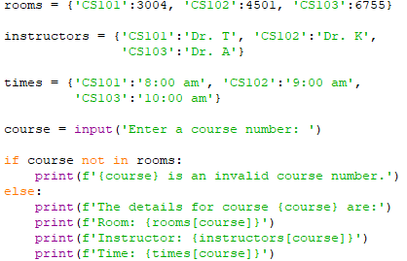
Exercise Solution

Slide 36
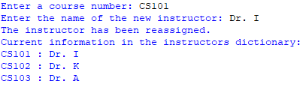
Exercise
Now, write a program that lets the user assign a new instructor for a course. Use the same three dictionaries from the previous program and as shown below.
rooms = {'CS101':3004, 'CS102':4501, 'CS103':6755}
instructors = {'CS101':'Dr. T', 'CS102':'Dr. K’, 'CS103':'Dr. A'}
times = {'CS101':'8:00 am', 'CS102':'9:00 am’, 'CS103':'10:00 am'}

Slide 37
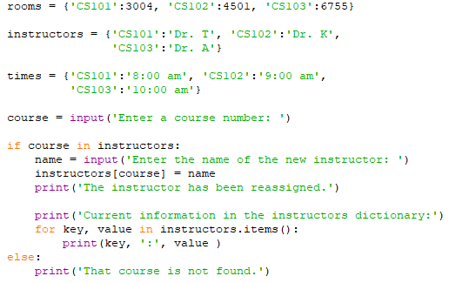
Exercise Solution

Slide 38

Exercise
Now, write a program that lets the user delete a course information if it exists in the three dictionaries. Use the same three dictionaries from the previous program and as shown below.
rooms = {'CS101':3004, 'CS102':4501, 'CS103':6755}
instructors = {'CS101':'Dr. T', 'CS102':'Dr. K’, 'CS103':'Dr. A'}
times = {'CS101':'8:00 am', 'CS102':'9:00 am’, 'CS103':'10:00 am'}

Slide 39
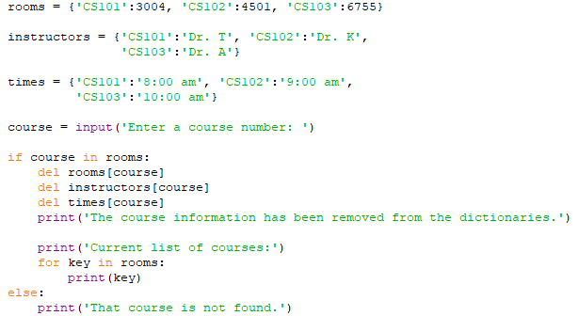
Exercise Solution

Slide 40
Sets
A set is an object that stores a collection of unique values.
Sets are unordered, which means that the elements in a set are not stored in any particular order.
The elements that are stored in a set can be of different data types.

Slide 41
Creating a Set
To create a set, you have to call the built-in set function.
The following creates an empty set:
  myset = set()
You can also pass one argument (and only one) to the set function.
  The argument that you pass must be an object that contains iterable elements, such as a list, a tuple, or a string.
  The individual elements of the object that you pass as an argument become elements of the set.
  myset = set(['a', 'b', 'c’])
  Here, a list is passed as an argument and the set will contain the elements 'a', 'b', and 'c'.

Slide 42
Creating a Set
If you pass a string as an argument to the set function, each individual character in the string becomes a member of the set. Here is an example:
  myset = set('aaabc')
  After this statement executes, the myset variable will reference a set containing just three elements 'a', 'b', and ‘c’.
  Note that sets cannot contain duplicate elements.

Slide 43
Creating a Set
Alternately, a set can also be created with curly braces by passing objects to it:
Example: myset = {5, 6}
Here, 5 and 6 will be the elements of the set, myset.
Note, that you cannot create an empty set using curly braces
  x = {}
  Here, x will be a dictionary and not a set.
  You can only create an empty set using the set function.

Slide 44
Getting the Number of Elements in a Set
You can use the len function to get the number of elements in a set.
  myset = set([1, 2, 3, 4, 5])
  print(len(myset))

Slide 45
Clearing a Set
You can clear all the elements of a set by calling the clear method.
  myset = set([1, 2, 3, 4, 5])
  myset.clear()
  print(myset) # prints set()

Slide 46
Add, Update and Remove Elements
Sets are mutable objects, so you can add items to them and remove items from them.
You use the add method to add an element to a set.
  myset = set()
  myset.add(1)
  myset.add(2)
  myset.add(2)
  print(myset) # {1, 2}

Slide 47
Add, Update and Remove Elements
You can add a group of elements to a set all at one time with the update method.
When you call the update method as an argument, you pass an object that contains iterable elements, such as a list, a tuple, string, or another set.
myset = set([1, 2, 3])
myset.update([4, 5, 6])
print(myset) # {1, 2, 3, 4, 5, 6}
set1 = set([1, 2, 3])
set2 = set([4, 5, 6])
set1.update(set2)
print(set1) # {1, 2, 3, 4, 5, 6}
myset = set([1, 2, 3])
myset.update('abc')
print(myset) # {1, 2, 3, 'a', 'c', 'b'}

Slide 48
Add, Update and Remove Elements
You can remove an item from a set with either the remove method or the discard method.
You pass the item that you want to remove as an argument to either method, and that item is removed from the set.
The only difference between the two methods is how they behave when the specified item is not found in the set. The remove method raises a KeyError exception, but the discard method does not raise an exception.

Slide 49
Add, Update and Remove Elements
  myset = set([1, 2, 3, 4, 5])
  print(myset) # {1, 2, 3, 4, 5}
  myset.remove(1)
  print(myset) # {2, 3, 4, 5}
  myset.discard(5)
  print(myset) # {2, 3, 4}
  myset.discard(99) # No error, nothing happens
  myset.remove(99)# Raises KeyError Exception

Slide 50
Using the for Loop, in, and not in Operators With a Set
A for loop can be used to iterate over the elements in a set.
  myset = set([1, 2, 3, 4, 5])
  for val in myset:
  print(val)
The in and not in operator can be used to test whether a value exists or not exists in a set.
  myset = set([1, 2, 3, 4, 5])
  if 1 in myset:
  print('The value 1 is in the set')

Slide 51
Finding the Union of Sets
Union of two sets: a set that contains all the elements of both sets
To find the union of two sets:
  Use the union method
    Format: set1.union(set2)
  Use the | operator
    Format: set1 | set2
set1 = set([1, 2, 3, 4])
set2 = set([3, 4, 5, 6])
set3 = set1.union(set2) # OR set3 = set1 | set2
print(set3) # {1, 2, 3, 4, 5, 6}

Slide 52
Finding the Intersection of Sets
Intersection of two sets: a set that contains only the elements found in both sets
To find the intersection of two sets:
  Use the intersection method
    Format: set1.intersection(set2)
  Use the & operator
    Format: set1 & set2
set1 = set([1, 2, 3, 4])
set2 = set([3, 4, 5, 6])
set3 = set1.intersection(set2) # OR set3 = set1 & set2
print(set3) # {3, 4}

Slide 53
Finding the Difference of Sets
Difference of two sets: a set that contains the elements that appear in the first set but do not appear in the second set
  Use the difference method
    Format: set1.difference(set2)
  Use the - operator
    Format: set1 - set2
set1 = set([1, 2, 3, 4])
set2 = set([3, 4, 5, 6])
set3 = set1.difference(set2) # OR set3 = set1 - set2
print(set3) # {1, 2}

Slide 54
Finding the Symmetric Difference of Sets
Symmetric difference of two sets: a set that contains the elements that are not shared by the two sets
  Use the symmetric_difference method
    Format: set1.symmetric_difference(set2)
  Use the ^ operator
    Format: set1 ^ set2
set1 = set([1, 2, 3, 4])
set2 = set([3, 4, 5, 6])
set3 = set1.symmetric_difference(set2)
# set3 = set1 ^ set2
print(set3) # {1, 2, 5, 6}

Slide 55
Finding Subsets
Set A is subset of set B if all the elements in set A are included in set B
To determine whether set A is subset of set B
  Use the issubset method
    Format: setA.issubset(setB)
  Use the <= operator
    Format: setA <= setB
set1 = set([1, 2, 3, 4])
set2 = set([2, 3])
print(set2.issubset(set1)) # True

Slide 56
Finding Supersets
Set A is superset of set B if it contains all the elements of set B
To determine whether set A is superset of set B
  Use the issuperset method
    Format: setA.issuperset(setB)
  Use the >= operator
    Format: setA >= setB
set1 = set([1, 2, 3, 4])
set2 = set([2, 3]) print(set1.issuperset(set2)) # True

Slide 57
Set Comprehensions
Set comprehension: a concise expression that creates a new set by iterating over the elements of a sequence
Set comprehensions are written just like list comprehensions, except that a set comprehension is enclosed in curly braces ({}) instead of brackets ([])

Slide 58
Set Comprehensions
Example: making a copy of a set
set1 = set([1, 2, 3, 4, 5])
set2 = {item for item in set1}
print(set2) # {1, 2, 3, 4, 5}

Slide 59
Set Comprehensions
Example: creating a set that contains the squares of the numbers stored in another set
set1 = set([1, 2, 3, 4, 5])
set2 = {item**2 for item in set1}
print(set2) # {1, 4, 9, 16, 25}

Slide 60
Set Comprehensions
Example: copying the numbers in a set that are less than 10
set1 = set([1, 20, 2, 40, 3, 50])
set2 = {item for item in set1 if item < 10}
print(set2) # {1, 2, 3}

Slide 61
Exercise
Consider the following two sets: one that holds the names of students on the baseball team, and another that holds the names of students on the basketball team.
baseball = set(['Ada', 'Diego', 'Elena', 'Ahmed'])
basketball = set(['Nia', 'Ahmed', 'Elena', 'Reuven’])
Write a program that performs the following operations:
Display the names of students who play both sports.
Display the names of students who play either sport.
Display the names of students who play baseball but not basketball.
Display the names of students who play one sport but not both.

Slide 62
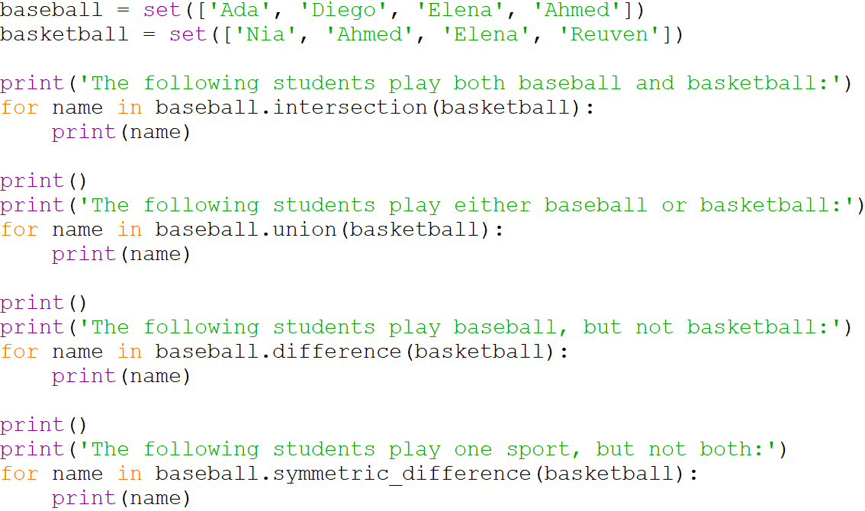
Exercise Solution

Slide 63
Exercise Solution
baseball = set(['Ada', 'Diego', 'Elena', 'Ahmed'])
basketball = set(['Nia', 'Ahmed', 'Elena', 'Reuven'])
print('The following students play both baseball and basketball:')
for name in baseball.intersection(basketball):
print(name)
print()
print('The following students play either baseball or basketball:')
for name in baseball.union(basketball):
print(name)
print()
print('The following students play baseball, but not basketball:')
for name in baseball.difference(basketball):
print(name)
print()
print('The following students play one sport, but not both:')
for name in baseball.symmetric_difference(basketball):
print(name)

Slide 64
Serializing Objects
Sometimes you need to store the contents of a complex object, such as a dictionary or a set, to a file.
The easiest way to save an object to a file is to serialize the object.
Serializing an object is the process of converting the object to a stream of bytes that can be saved to a file for later retrieval.
In Python, object serialization is called pickling.
The Python standard library provides a module named pickle that has various functions for serializing, or pickling, objects.

Slide 65
Serializing Objects
To pickle (serialize) and unpickle (retrieve) an object:
  Import the pickle module
  Open a file for binary writing or reading
  Call the pickle.dump method to pickle the object (s) and write it to a specified file, OR
  Call the pickle.load method to retrieve and unpickle an object
    Format: pickle.dump(object, file_object)
    Format: pickle.load(file_object)
  Close the file

Slide 66
Serializing Objects
Example
import pickle
phonebook = { 'Joanne' : '555-1111', 'Chris' : '555-2222' }
with open('phonebook.dat', 'wb') as output_file:
pickle.dump(phonebook, output_file)
with open('phonebook.dat', 'rb') as input_file:
pb = pickle.load(input_file)
print(pb) # {'Joanne': '555-1111', 'Chris': '555-2222'}

Slide 67
Summary
This chapter covered:
  Dictionaries
  Sets
  Serializing Objects

